Slide 1
Importing RTF, DOC, and PDF
PrintNet T

Slide 2
Context Schema
Workflow
Data Input
&
Manipulation
Document
Design
(Layout)
Impositioning
Approval (Proof)
Spool Production
Notes:
External documents are imported into PrintNet T Layout.

Slide 3
Agenda
Importing .RTF and .DOC Files
Importing .PDF Files

Slide 4
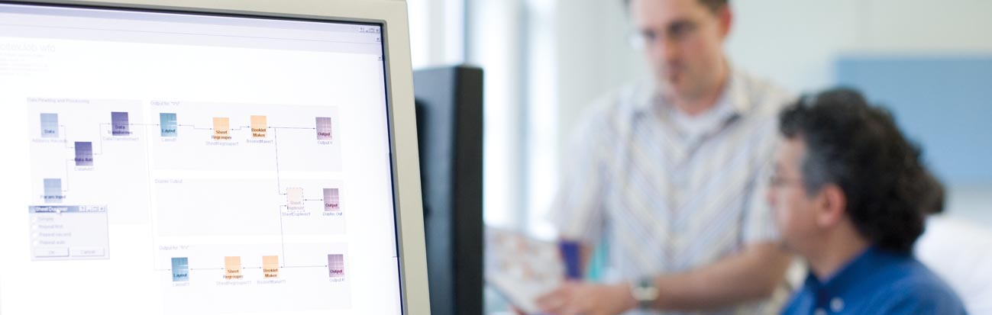
1. Importing .RTF and .DOC Files

Slide 5

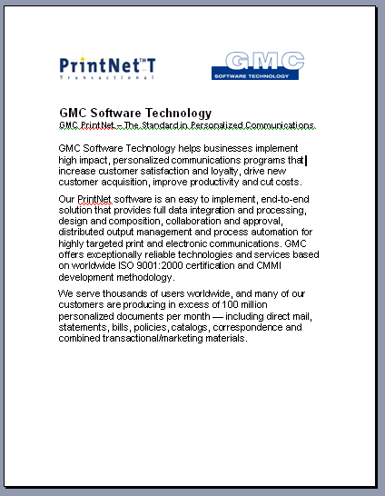
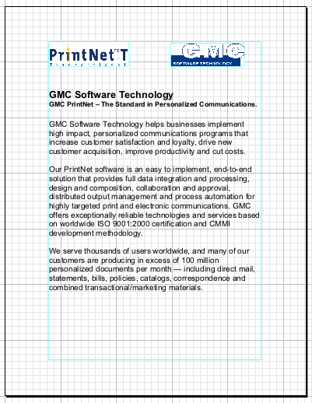
Importing – Introduction
Importing allows you to take a previously created document and work with it in PrintNet T.
.DOC file in MS Word
Imported .DOC file in PrintNet T

Slide 6

Importing .DOC Files – Purpose
PrintNet T is not intended as a word processor.
Documents can be prepared in MS Word or another text editor that can export .RTF format.
Importing .DOC or .RTF files can make designing in Layout work much faster.

Slide 7
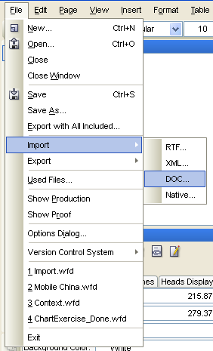
Importing .DOC Files
To Import a .DOC file:
  Open Layout module
  Menu: File | Import | DOC

Slide 8
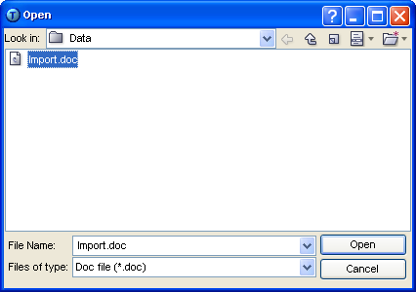
Importing .DOC Files
Browse for the intended file in the pop-up browser.

Slide 9
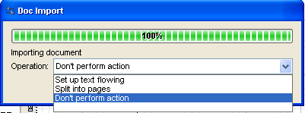
Importing .DOC Files
After clicking OK, another dialog will appear.
When the import is 100% complete, an import operation will need to be defined.
Notes:
For .DOC and .RTF imports, an import operation needs to be defined. Which operation is chosen depends on how a user wants PrintNet T to treat their .DOC import,.
The following options are available in the Operation combo-box:
Set up text flowing – Document is imported on one page and flowing gets set up for this page.
Split into pages – Document is imported on more pages (as many pages as are necessary get created).
Don’t perform action – Document gets all imported in one flow on one page, no flowing is set up.
For small documents, just select “Don’t perform action”

Slide 10
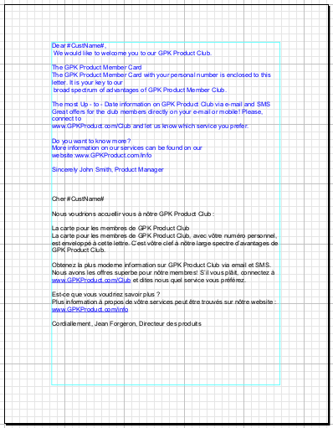
Importing .DOC Files
“Don’t perform action”:
  Short files will be displayed in full on one page.

Slide 11
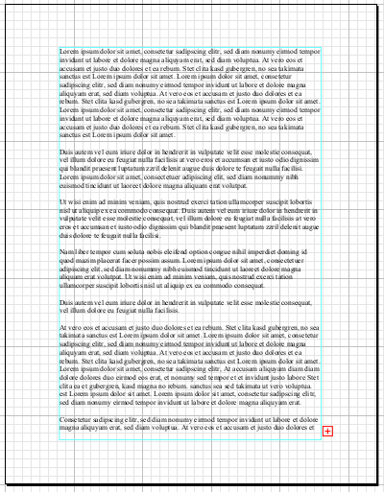
Importing .DOC Files
“Don’t perform action”
  Longer files will be put into one flow area on one page, with no overflow logic.
Vertical overflow indicator

Slide 12
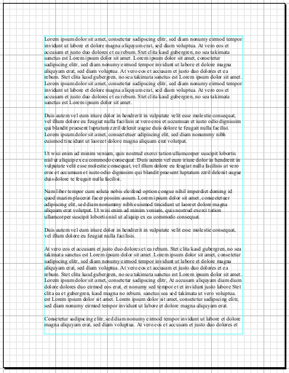
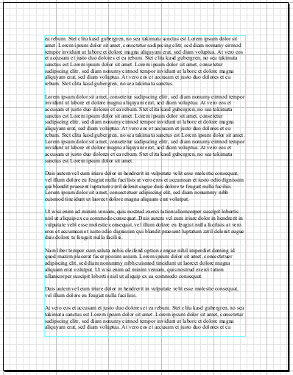
Importing .DOC Files
“Split into pages”:
Longer files will be split into as many pages as are needed.
No overflow; flows to next page
Page 1
Page 2

Slide 13
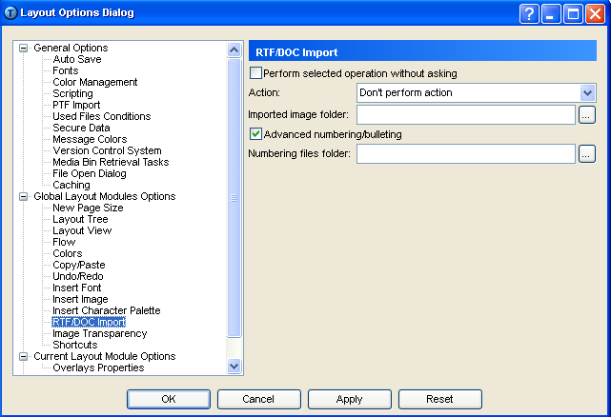
Importing .DOC Files – Options Dialog
Additional settings for importing .DOC and .RTF files can be set in File | Options Dialog

Slide 14
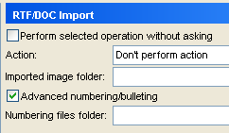
Advanced Numbering/Bulleting
If “Advanced numbering/bulleting” is checked, then imported documents which contain bullets (prior to being imported) will have the functionality of adding to the bullets

Slide 15

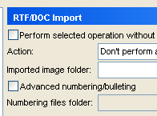
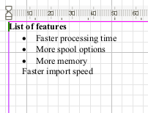
Advanced Numbering/Bulleting – Example
Imported bullets without Advanced bullets/numbering checked.
No bullet after hitting <Enter>

Slide 16
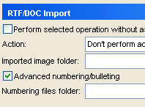
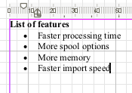
Advanced Numbering/Bulleting – Example
Imported bullets with Advanced bullets/numbering checked.
Bullet appears after hitting <Enter>

Slide 17
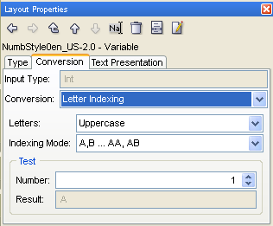
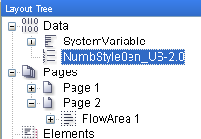
Advanced Numbering/Bulleting
If the imported document contains numbered bullets, it is possible to further change the output format of the bullets.
New variable Layout Properties
New variable in Layout tree

Slide 18
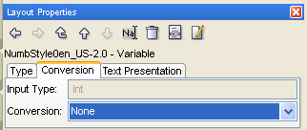
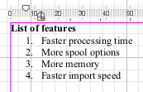
Advanced Numbering/Bulleting – Example
Number bullets to “None”.

Slide 19
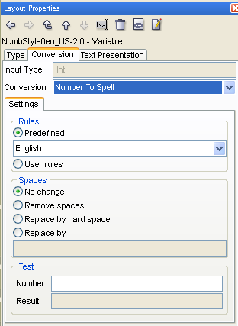
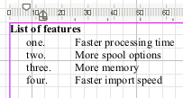
Advanced Numbering/Bulleting – Example
Number bullets to “Number To Spell”.

Slide 20
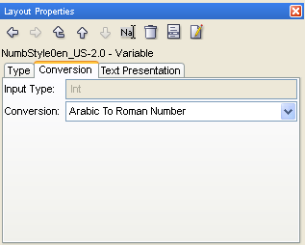
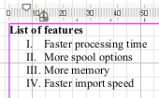
Advanced Numbering/Bulleting – Example
Number bullets to “Arabic to Roman Number”.

Slide 21

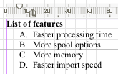
Advanced Numbering/Bulleting – Example
Number bullets to “Letter Indexing”.

Slide 22

Importing .DOC Files – Exercise
Import a document and format the bullets.
  Create a new workflow and insert a Layout module
  In Layout, set your Options Dialog to include Advanced numbering/bulleting
  Import ImportExercise.doc or ImportExercise.rtf
  Add a ninth bullet to the list: “Platform and printer independence”
  Format the bullets so that they are listed by letters A, B, C, etc.
Notes:
See ImportExercise_done.wfd for resolution.

Slide 23
2. Importing .PDF Files

Slide 24
Importing .PDF Files – Purpose
PrintNet T can create .PDF files in Production.
Usually, .PDF files are not possible to edit or change in any way.
Importing .PDF files into PrintNet T allows the possibility to change and alter their content by working with single objects that these files contain.

Slide 25
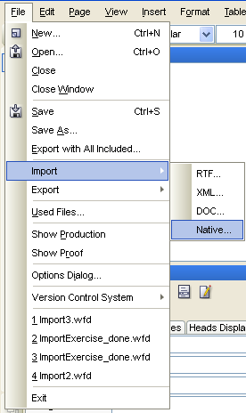
Importing .PDF Files
To Import a .PDF file:
  Open Layout module
  Menu: File | Import | Native…
Notes:
It is called “Native”, because PrintNet T can create and support these types of files natively (as well as .AFP files, .TNO files, etc.)

Slide 26
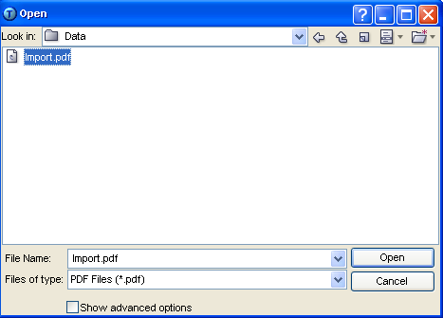
Importing .PDF Files
Browse for the intended file in the pop-up browser

Slide 27
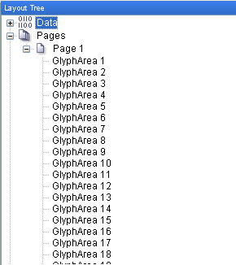
Importing .PDF Files
Notice that with .PDFs, the imported objects are not flow areas, but glyph areas.
Notes:
A glyph area is an object that is created in Layout when importing files to contain an object that has been defined as text. It could be also be described as a map of glyphs. A glyph is the information that provides the shape and type-face of a text character.
For more, see: http://en.wikipedia.org/wiki/Glyph

Slide 28
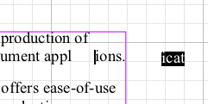
Importing .PDF Files
Glyphs do not behave the same way as flows do.
It is possible to actually remove part of a glyph and place it elsewhere on the Layout page.
Notes:
The glyphs in the glyph area can be modified like standard flows in a flow area, when the Flow Area Tool is activated.
The content of a glyph area can also be dragged and dropped within or outside the boundaries of a glyph area. If glyphs have been placed outside of the boundaries of a glyph area, you must adjust the boundaries of the glyph area to include those glyphs in order to edit them.

Slide 29
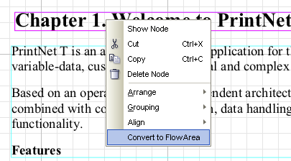
Importing .PDF Files
Glyph areas can be converted to flow areas by right-clicking on them and selecting “Convert to Flow Area”.

Slide 30
Importing .PDF Files – Exercise
Import a .PDF document and convert some glyph areas.
  Create a new workflow and insert a Layout module
  Import ImportExercisePDF.pdf
  Play with the glyph areas; drag some off the page, convert some to flow areas, etc.
Notes:
See ImportExercisePDF_done.wfd for resolution.

Slide 31

Importing – Summary
In this presentation we have learned:
How to:
  Import .RTF, .DOC, and .PDF files into PrintNet T Layout.
  Split .RTF and .DOC imports into more than one page/flow area.
  Change settings for advanced number and bulleting for imports.
  Change the bullet format output for imported .RTF and .DOC files
  Convert glyph areas into flow areas with .PDF imports.
Notes:
.RTF files are almost essentially the same as .DOC files. .DOC is the extension for MS Word, but .DOC files can be saved as .RTF files as well, and opened in other word processing browsers. In general, there are fewer problems when importing .RTF files, because MS Word has special coding and features not supported by PrintNet T.

Slide 32

Importing – Discussion
What do you have to specify for lengthy .DOC imports?
Where do you set advanced numbering and bulleting?
How do you import a .PDF file?
What is a glyph area?
Notes:
1. What do you have to specify for lengthy .DOC imports?
Import operation: do you want your long document in one flow area on one page with no overflow, or do you want PrintNet T to create as many pages as are needed for your document to fit?
2. Where do you set advanced numbering and bulleting?
File | Options Dialog.
3. How do you import a .PDF file?
File | Import | Native… and select your .PDF file location.
4. What is a glyph area?
A glyph area is an object that is created in Layout when importing files to contain an object that has been defined as text.

Slide 33

Thank You.
Do You Have Any Questions?

